Slide 1
Group 5: social determinants of health
Michelle Kubicki, Jonathan Himes, Lucia Ranallo, Yueqin Yang, Jacqueline Bearnson

Slide 2
Background and Motivation
Social determinants of health (SDOH) are nonmedical factors that can influence health outcomes
Conditions in which people live and the broader set of influences creating conditions of daily life
Not readily available on individual level in electronic health records, making them difficult to incorporate
Available large scale on tools such as census

Slide 3
Project Objectives
In order to successfully incorporate SDOH data into change-generating practices, it should first be extracted from available resources such as censuses
Preceded by identification of variables of interest based on previous research
Extracted data to be assessed for quality and if needed, cleaned and transformed to make suitable for analysis

Slide 4
Dataset
“FACETS: using open data to measure community social determinants of health” by Michael N Cantor, Rajan Chandras, and Claudia Pulgarin
Example dataset

Slide 5
Must-Have Features
1. A clear and concise description of the SDOH variables used in the analysis.
2. SDOH variables for every census tract in the state of Utah for 2018 and 2019
3. A cleaned and transformed dataset that is suitable for analysis.
4. Identification and treatment of missing data and outliers.
5. Exploratory Data Analysis (EDA) of the Data to understand distributions and skewness
6. Statistical Comparison of changes in SDOH between the 2 years

Slide 6
Dataset
Item | Description | Source
FIPS | US Census 11 digit FIPS code for tract | US Census
Urban | Urban/Rural Flag | USDA Food Access Research Atlas
Total population | Total Population | ACS 2015 Estimates
P_WH | % White | ACS 2015 Estimates
P_AA | % African-American | ACS 2015 Estimates
P_AI | % American Indian | ACS 2015 Estimates
P_AS | % Asian | ACS 2015 Estimates
P_NH | % Native Hawaiian/Pacific Islander | ACS 2015 Estimates
P_OR | % Other Race | ACS 2015 Estimates
P_2R | % 2 or more Races | ACS 2015 Estimates
P_Latino | % Latino/Hispanic Ethnicity | ACS 2015 Estimates
P_native | % Native Born in US | ACS 2015 Estimates
P_FB | % Foreign Born | ACS 2015 Estimates
P_citizen | % US Citizen | ACS 2015 Estimates
P_non-citizen | % Non-citizen | ACS 2015 Estimates
P_NoSchool | % No schooling | ACS 2015 Estimates
P_HS_no_degree | % completed high school, no degree | ACS 2015 Estimates
P_HS_or_GED | % High school or GED degree | ACS 2015 Estimates
P_some_college | % Some college, no degree | ACS 2015 Estimates
P_college_degree | % AA or BA | ACS 2015 Estimates
P_Masters_prof_doc | % Masters, professional, doctorate | ACS 2015 Estimates
P_Other | % Other level of schooling (< High school) | ACS 2015 Estimates
P_limited_eng | % Limited English proficiency | ACS 2015 Estimates
Poverty_rate | % in poverty | ACS 2015 Estimates
MED_HH_income | Median Household Income | ACS 2015 Estimates
UE_rate | Unemployment rate | ACS 2015 Estimates
P_UI | % Uninsured (health) | ACS 2015 Estimates
P_Insured | % Insured | ACS 2015 Estimates
P_UI_under_18 | % Uninsured, <18 yo | ACS 2015 Estimates
P_UI_18-64 | % Uninsured, age 18-64 | ACS 2015 Estimates
P_UI_65_over | % Uninsured, over 65 | ACS 2015 Estimates
P_any_private_ins | % Any private insurance, all ages | ACS 2015 Estimates
P_any_public_ins | % Any public insurance, all ages | ACS 2015 Estimates
P_Medicare_alone | % Medicare only | ACS 2015 Estimates
P_Medicaid_alone | % Medicaid only | ACS 2015 Estimates
Resp_HI | Respiratory Hazad Index | EPA National Air Toxics Assessment, 2011
Low_access | Low access to healthy food (1/2 mile) | USDA Food Access Research Atlas
Park_distance | Population-weighted distance to closest 7 parks | CDC
Walkscore | Neighborhood walkability scale | Rundle- Columbia BEH
Walkscore_percentile | Percentile of walkabiliity (higher better) | Rundle- Columbia BEH
Tob_retailer_per_1000 | Tobacco retailers/1000 population | NYS open data- active tobacco retailers
Crime_per_1000 | # of 7 serious crimes /1000 population | NYC open data nypd all felony incidents geocoded
GINI | GINI inequality index | US Census
SVI_themes_total | Social Vulnerability index- total themes percentile- higher is more vulnerable | CDC SVI
SVI_flags | Social Vulnerability index- score for flags | CDC SVI
Housing_violations_per_1000 | Housing violations per 1000 rental units | Furman center
Voter Turnout | Voter Turnout | BOE (by state assembly district 2014)
Turnout quartile | Turnout Quartile | BOE calculated

Slide 7
Data Processing
Data harmonization project: matching required dimensions to the correct geographical region
Some data in the form of .accdb will be transformed into .csv format
Every source dataset will be truncated to only include Utah data before any harmonization will take place
Missing or null data values will be checked for to ensure quality

Slide 8
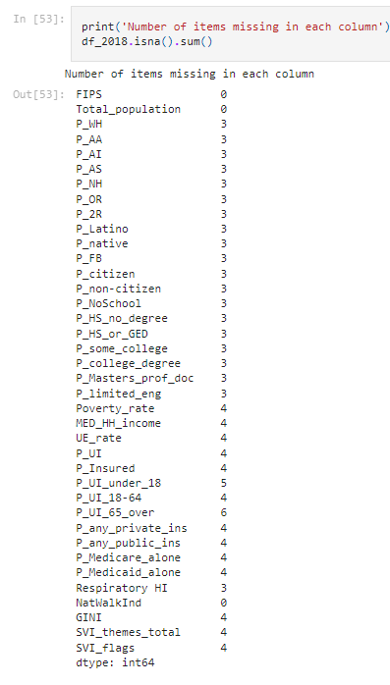
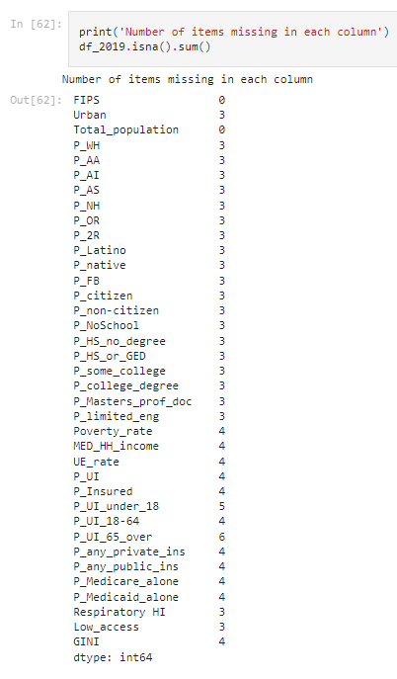
Check missing values

Slide 9
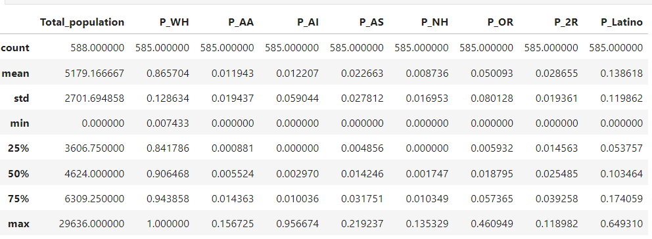
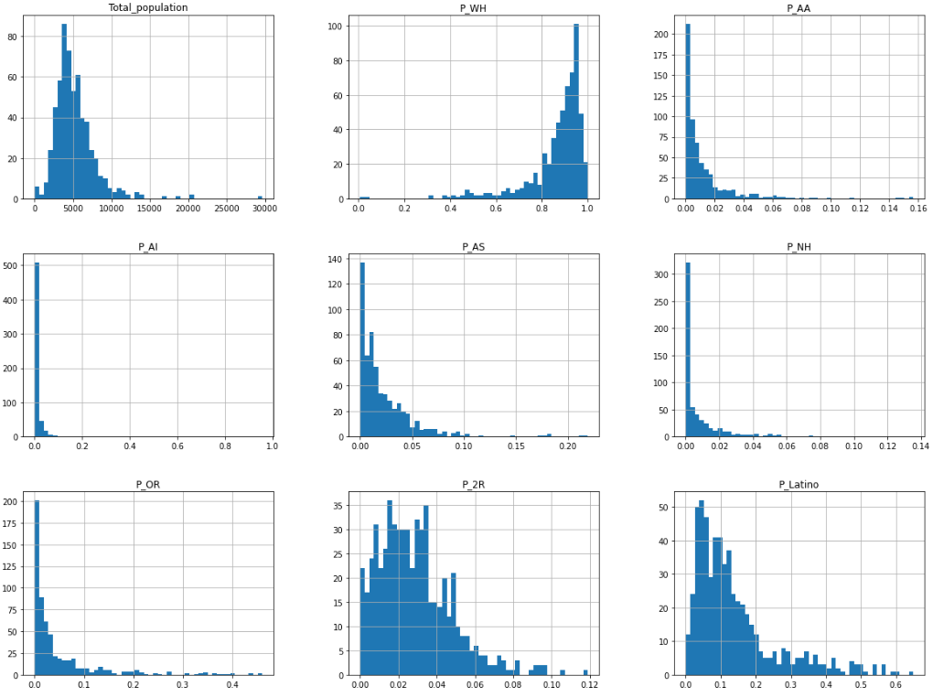
Data Exploration 2018 Data Exploration

Slide 10
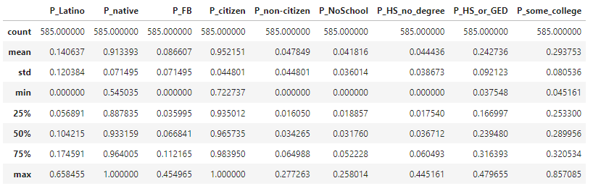
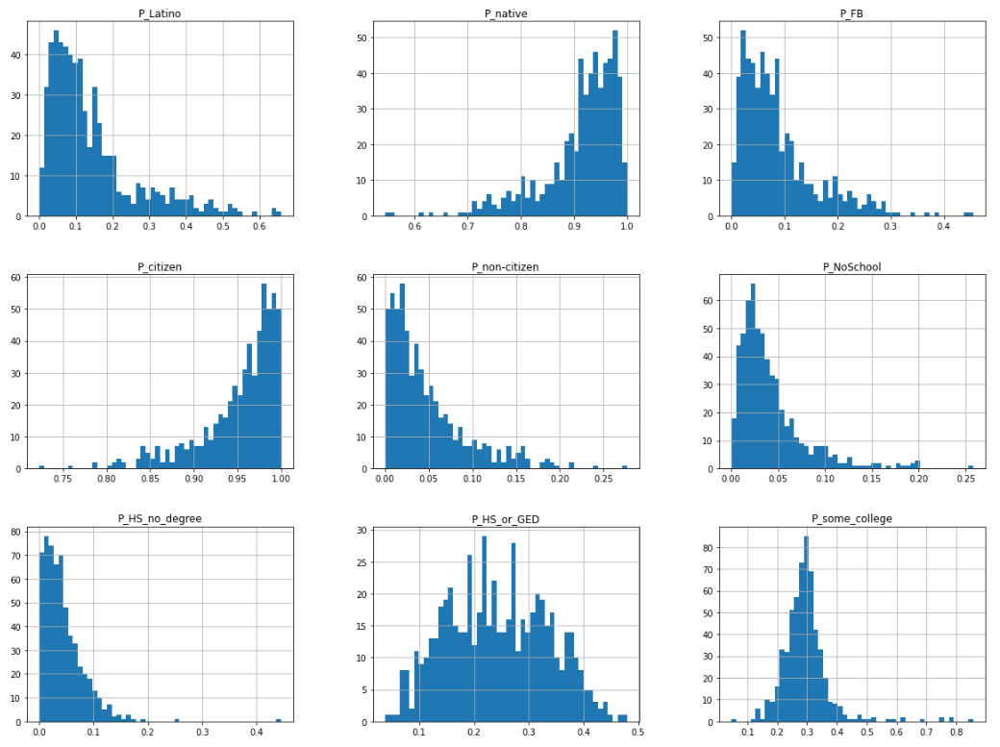
Data Exploration 2019 Data Exploration

Slide 11
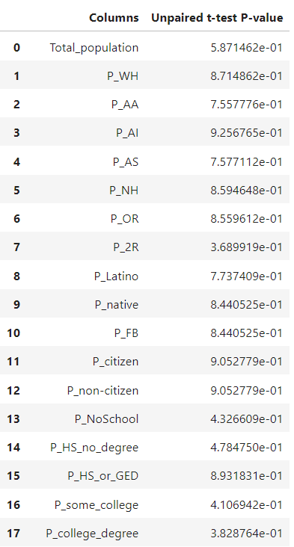
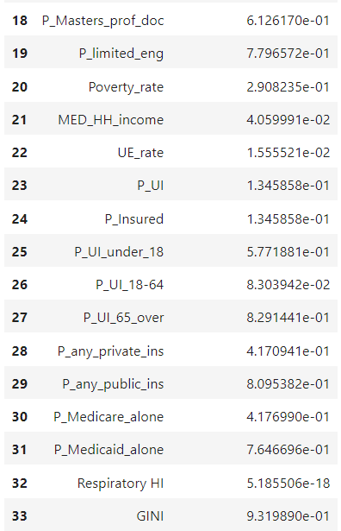
Data Comparison
unpaired t test
-Calculated the p values for the SDOHs between 2018 and 2019

Slide 12
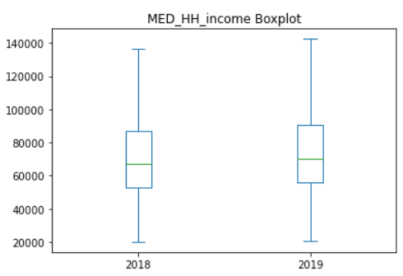
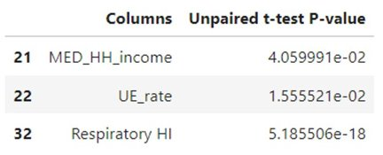
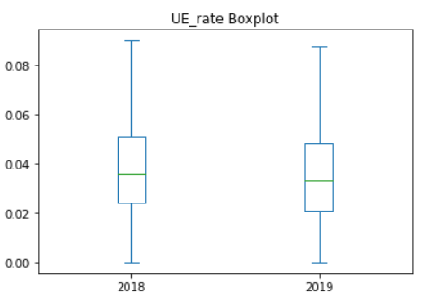
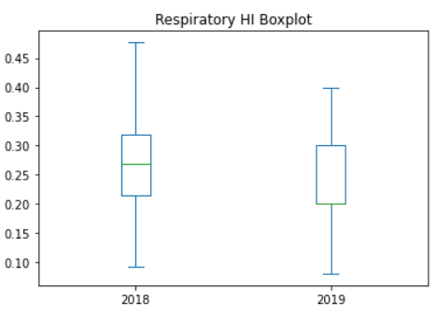
2018 Vs 2019 SDOHs Significant differences
UE_rate - unemployment rate
MED_HH_income - median household income
Respiratory HI - Respiratory Hazard Index

Slide 13
Questions?

Slide 14
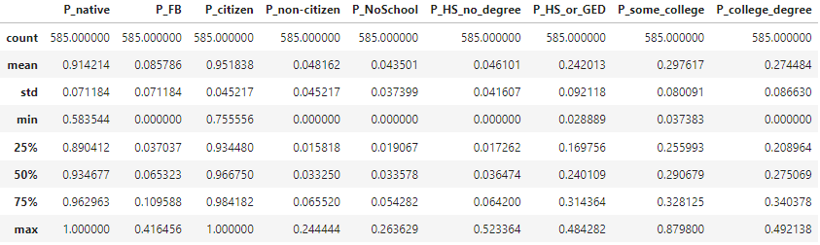
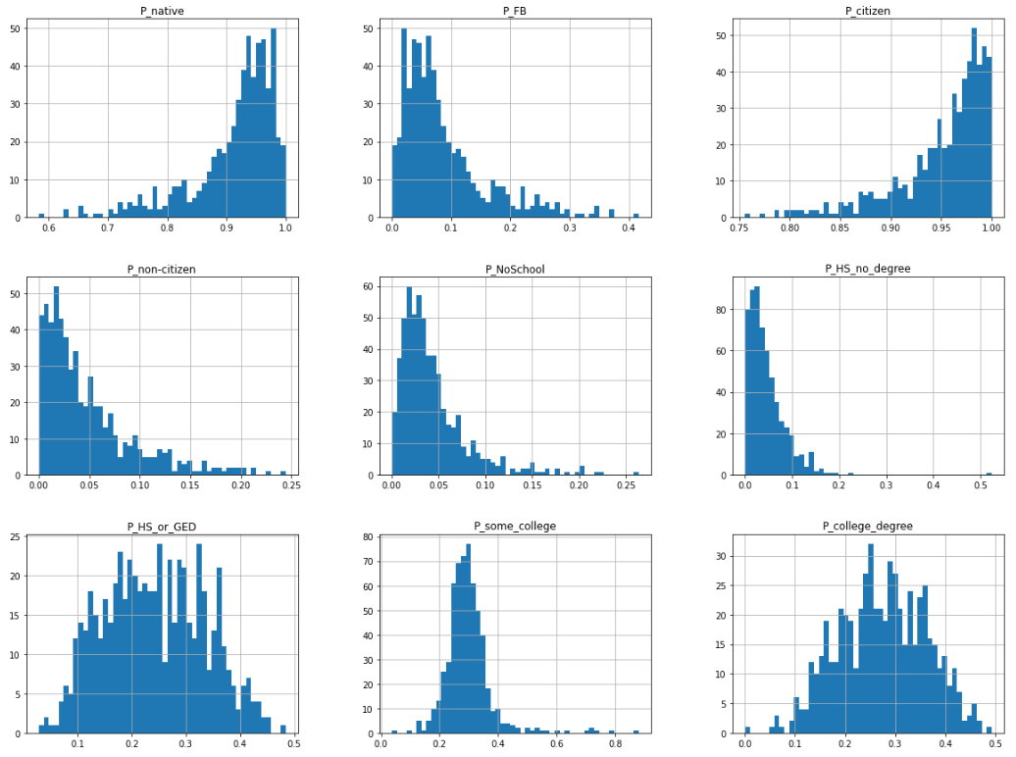
Data Exploration 2018 Data Exploration

Slide 15
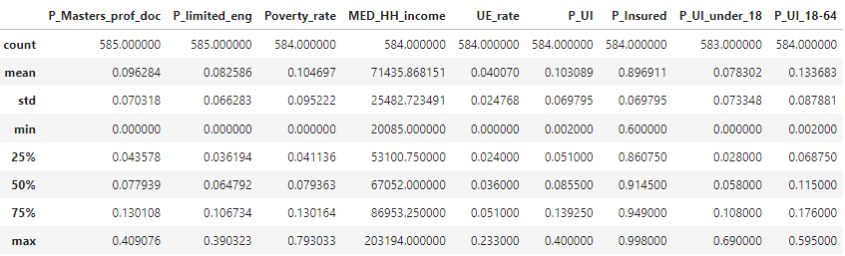
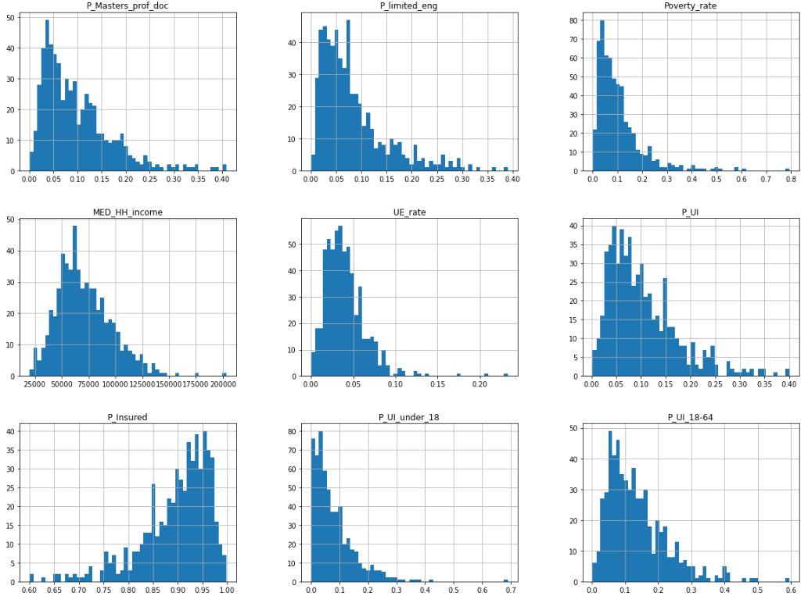
Data Exploration 2018 Data Exploration

Slide 16
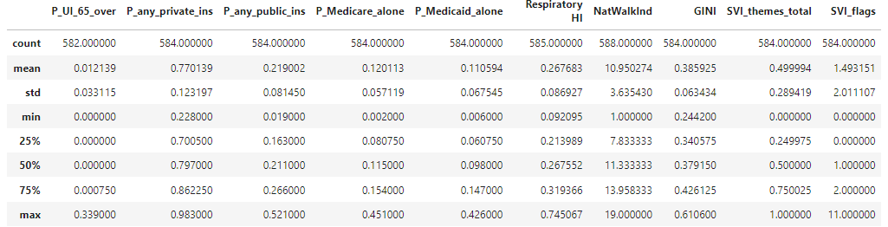
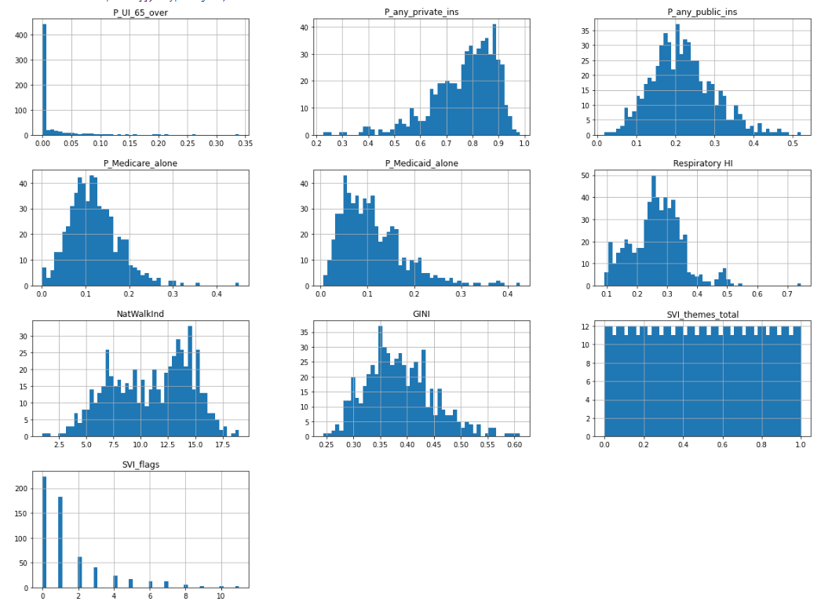
Data Exploration 2018 Data Exploration
Interpretation: The data descriptions and histograms were reviewed looking for any data that seemed out of place. The data was found to be acceptable.

Slide 17
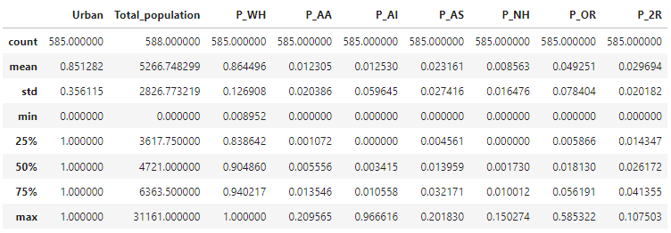
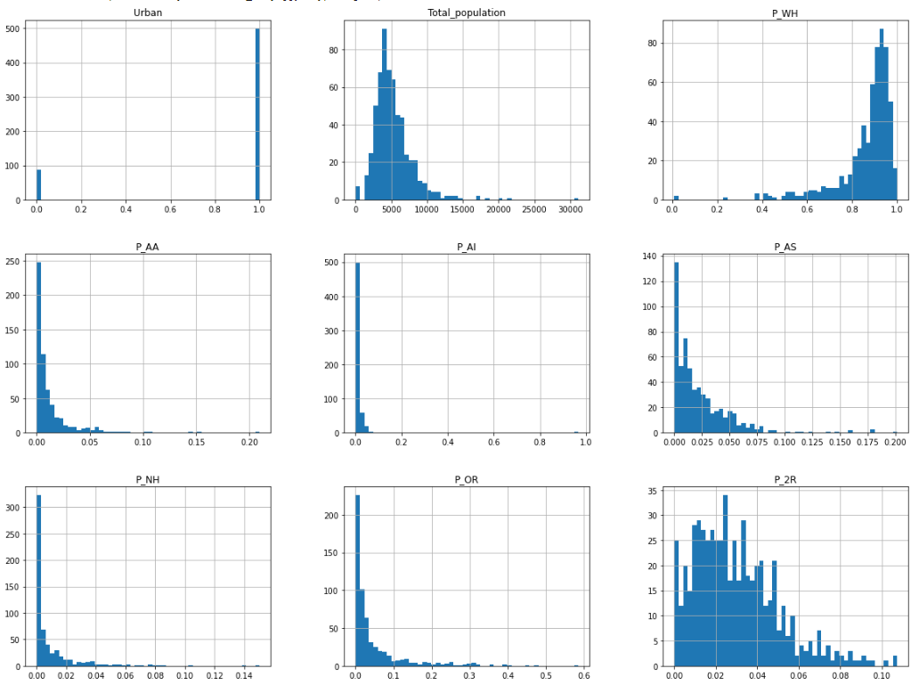
Data Exploration 2019 Data Exploration

Slide 18
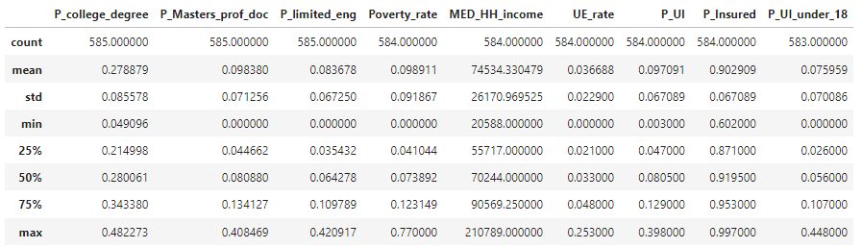
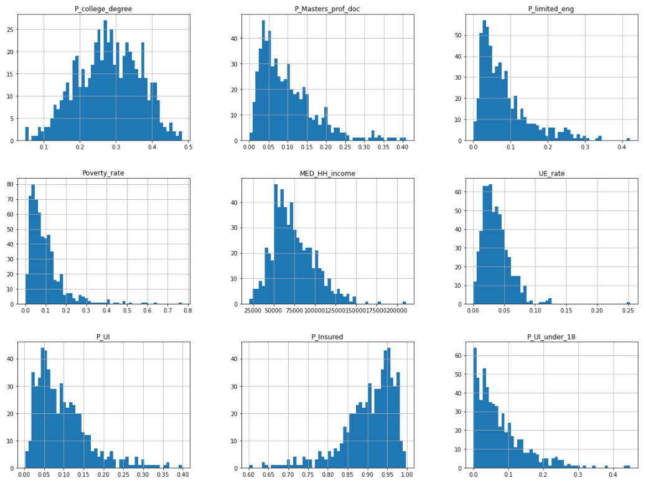
Data Exploration 2019 Data Exploration

Slide 19
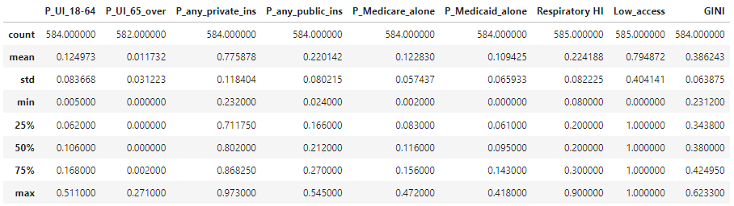
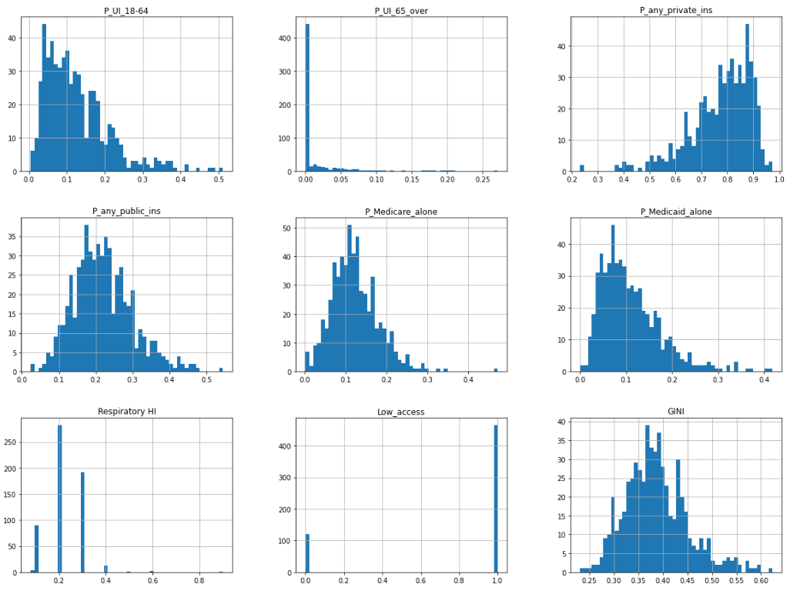
Data Exploration 2019 Data Exploration Interpretation: The data descriptions and histograms were reviewed looking for any data that seemed out of place. The data was found to be acceptable.

Slide 20
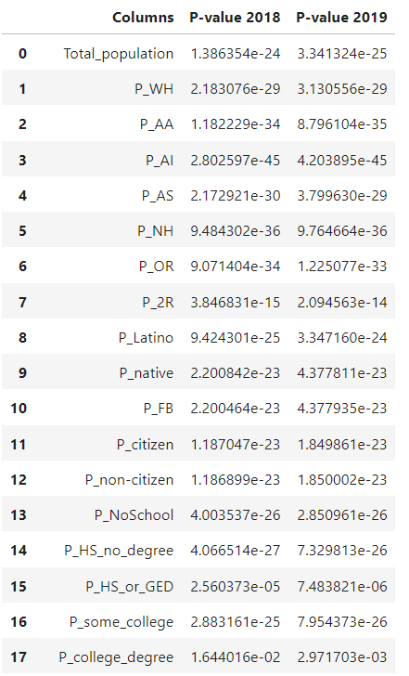
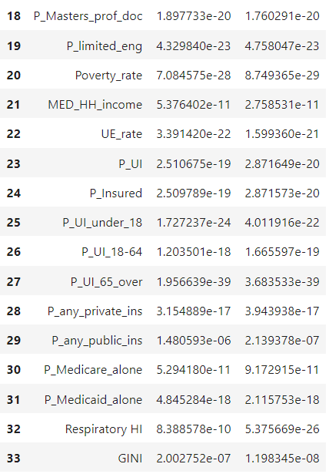
Data Comparison
Shapiro test
-Check that all columns are normally distributed

Slide 21
Outcome
Data extraction, harmonization, cleaning completed
Difficulty with some data sources
Performed statistical analysis to identify differences between 2018 and 2019 SDOHs

